Slide 1


Previous spatial modelling: What is Cube Land?
Software of a stochastic economic model that simulates and forecasts the state of the urban real estate market (land use) under user-defined scenarios, accounting for its interaction with the transportation system.
Cube Land
Transport access levels
by agent category and zone
Predetermined part of real estate supply
Number of agents to be located
Regulations on supply and location
Subsidies and Taxes
by agent category,
real estate type and zone
by real estate type and zone
by agent category
by agent category,
real estate type and zone
Equilibrium between real estate supply and demand
Transportation system
Occupied real estate supply
Location of agents
Real estate rents
Cube Land is worldwide distributed by
by real estate type and zone
by agent category,
real estate type and zone
by real estate type and zone
© 2020 Bentley Systems, Incorporated

Slide 2
Key features of the model supporting Cube Land
Supply
Developers/consumers produce/choose properties to maximize profits/utilities
Market operates as an auction:
Goods are quasi-unique: real estates are differentiated by location
Consumers (households and firms) are allocated where they are maximum bidders
Real estate prices/rents are the highest location bids
Location decisions and prices/rents are affected by real estate development and location of other agents in the neighborhood (externalities)
The real estate supply consists of one part that is preserved and another that is new either with or without demolition
The real estate production is subject to economies of scale
It exists location equilibrium: “all consumers are located”. This condition also determine the total supply
Multiple interaction between supply and demand components and rents are represented in the model as shown in this figure
Total supply in equilibrium
determines
affects
determines
Real estate supply
Supply externalities
affects (if economies of scale exist)
determines
Production costs
affects
Profits
Rents
affects
determines
Rents
Demand
Location
affects
determines
affects
Location externalities
Location equilibrium
affects
determines
is met with changes in
Bids
affects

Slide 3
What can Cube Land be used for?
Cube Land
Design and appraisal of large real estate projects, real estate project portfolio and Land Use policies, programs and plans, by considering:
demographic and economic trends
real estate and location externalities
zonal transportation access levels
land use regulations and incentives
real estate projects in development or planned simultaneously
Transport access levels
Real estate projects
Development plans
by agent category and zone
Demographic and economic growth
Real estate and location policies
Predetermined part of real estate supply
Number of agents to be located
Regulations on supply and location
Subsidies and Taxes
by agent category,
real estate type and zone
by real estate type and zone
by agent category
by agent category,
real estate type and zone
Transportation infrastructure and service projects and policies
Better design and appraisal of Transportation projects, policies, programs and plans by:
improving the estimation of travel demand by considering different Land Use scenarios and the ability of these transport initiatives to induce relocation of households and firms.
capturing their impacts on Land Use either because they yield social or private benefits and/or externalities
Equilibrium between real estate supply and demand
Transportation system
Occupied real estate supply
Location of agents
Real estate rents
by real estate type and zone
by agent category,
real estate type and zone
by real estate type and zone
Location bids
by agent category,
real estate type and zone

Slide 4







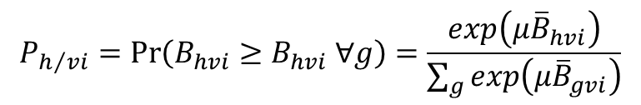
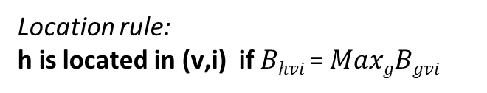

First Example: Cape Town—modeling willingness to pay for location
Residential market
Zone $i$
Location rule:
h is located in (v,i) if $Bhvi$ = $MaxgBgvi$
Dwelling type $v$
$$P_{h/vi}=\operatorname{Pr}\left(B_{hvi}≥B_{hvi} ∀g\right)=\frac{exp\left(μ{\overline{B}}_{hvi}\right)}{\sum_{g}{exp\left(μ{\overline{B}}_{gvi}\right)}}$$
Household type $h$
$$B_{hvi}={\overline{B}}_{hvi}+ε_{hvi}$$
$$Bhvi = w0h∗yh + w1h∗dvi + w2h∗zi + w3h∗acchi$$
Household attributes
Dwelling/Building attributes
Neighborhood (zonal) attributes
Access attributes
Income
Size
Life cycle
Ethnicity
Building type
Built area
Lot size
Building amenities
Residential Income
Green areas
Industrial area
Retail area
Services area
Nº of bus/stops in zone
Travel times
Land use that can be reached in a time window
Notes:
Explain what the model was used for, whether it was dynamic (time dependent) or strictly cross sectional

Slide 5
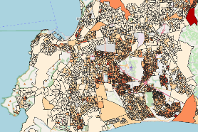
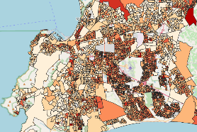
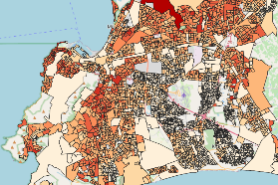
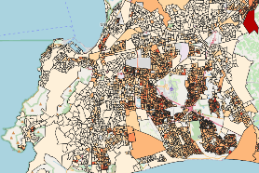
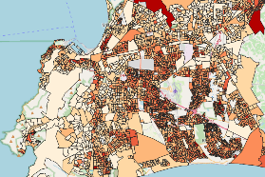
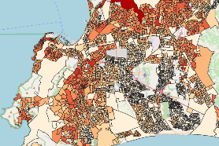
Cape Town Cube Land model: residential location estimates by zone (5,000 zones)
Lowest income
Medium income
Highest income
observed
modelled

Slide 6
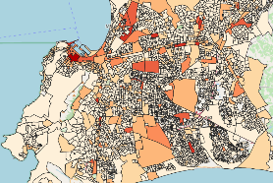
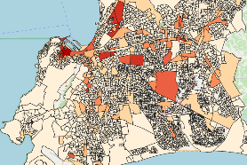
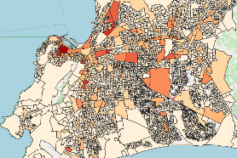
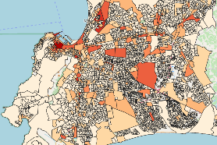
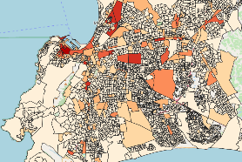
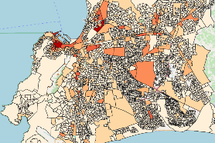
Cape Town Cube Land model: employment location estimates by zone (5,000 zones)
Trade
Finance
Government and Social Services
observed
modelled

Slide 7

Second example: sale price model of residential apartments in Santiago
Hedonic regression model
Machine learning model
Neural network model
$$p_{vi}=f\left(dvi,z_{e\left(i\right)},{acc}_{e\left(i\right)}\right)$$
Apartment/Building attributes
Egocentric neighborhood attributes
Access attributes
Built area
No of bedrooms and bathrooms
No of apartments in the building
Building amenities
Residential density
Green areas
Industrial area
Retail area
Services area
Distance to the closest Metro station
Travel times to CBD
No of transit stops in the egocentric neighborhood
Notes:
Explain concentric circles, purpose of model, explanatory variables, approach, etc. Mention that this is close to what we are proposing

Slide 8
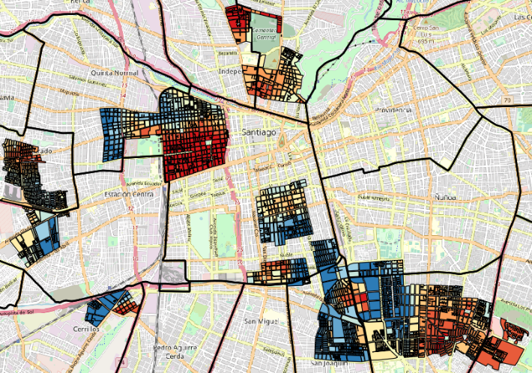
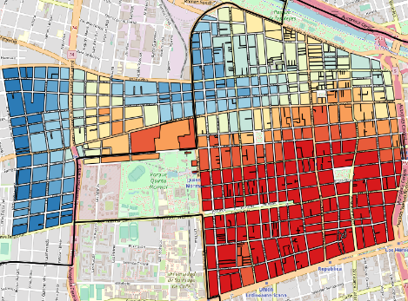
Identifying real estate development locations with the model

Slide 9
A New Approach to Modelling Real Estate Markets
A bottoms-up construction of cap rates
Theoretical context
October 2020

Slide 10


















Model deep dive: structure of decisions in period $t$
1
Existing assets
New assets
Total of assets
Demolished asset $v$ in $t$
Asset $v$ in period $t$
Macro-spatial level
Asset $v$
in period $t−1$
New asset $v$ in period $t$
Asset $v$
in period $t−1$ in zone $1$
Asset $v$
in period $t−1$ in zone $i$
Asset $v$
in period $t−1$ in zone $Z$
Zonal level
($v$,$i$)
for sale in $t$
($v$,$i$)
out of the market in $t$
Asset $v$
in period $t$ in zone $1$
Asset $v$
in period $t$ in zone $i$
Asset $v$
in period $t$ in zone $Z$
($v$,$i$)
sold in $t$
($v$,$i$)
not sold in $t$
($v$,$i$)
sold in $t$
($v$,$i$)
not sold in $t$
($v$,$i$) demolished in $t$
($v$,$i$)
kept in $t$

Slide 11



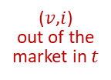















Model deep dive: structure of decisions in period $t$
1
Existing assets
New assets
Total of assets
Demolished asset $v$ in $t$ $D_{vt}$
Asset $v$ in period $t$ $S_{vt}$
Macro-spatial level
Asset $v$
in period $t−1$ $S_{v\left(t−1\right)}$
New asset $v$
in period $t$
$$N_{vt}=S_{vt}−S_{v\left(t−1\right)}+D_{vt}$$
Asset $v$
in period $t−1$ in zone $1$
$$S_{v1\left(t−1\right)}$$
Asset $v$
in period $t−1$ in zone $i$ $S_{vi\left(t−1\right)}$
Asset $v$
in period $t−1$ in zone $Z$
$$S_{vZ\left(t−1\right)}$$
Asset $v$
in period $t$ in zone $1$ $N_{v1t}$
Asset $v$
in period $t$ in zone $Z$ $N_{vZt}$
($v$,$i$)
for sale in $t$
$$M_{Evit}=S_{vi\left(t−1\right)}P_{Evit}$$
($v$,$i$)
out of the market in $t$
Asset $v$
in period $t$ in zone $i$ $N_{vit}=N_{vt}P_{Nvit}$
Zonal level
($v$,$i$)
sold in $t$
$$O_{Evit}=M_{Evit}P_{Svit}$$
($v$,$i$)
not sold in $t$
($v$,$i$)
sold in $t$
$$O_{Nvit}=N_{vit}P_{Svit}$$
($v$,$i$)
not sold in $t$
Asset $v$
in period $t$
in zone $i$
$$S_{vit}=S_{vi\left(t−1\right)}−D_{vit}+N_{vit}$$
($v$,$i$) demolished in $t$ $D_{vit}=O_{Evit}P_{Dvit}$
($v$,$i$)
kept in $t$

Slide 12






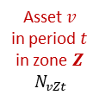

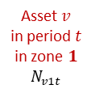


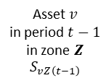
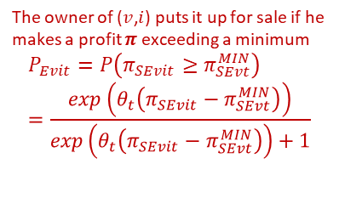



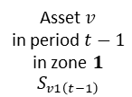


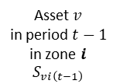


Model deep dive: structure of decisions in period $t$
1
Existing assets
New assets
Total of assets
Demolished asset $v$ in $t$ $D_{vt}$
Asset $v$ in period $t$ $S_{vt}$
Macro-spatial level
Asset $v$
in period $t−1$ $S_{v\left(t−1\right)}$
New asset $v$
in period $t$
$$N_{vt}=S_{vt}−S_{v\left(t−1\right)}+D_{vt}$$
Given values obtained from the previous period (it is observed in the first modelled period)
Asset $v$
in period $t−1$ in zone $1$
$$S_{v1\left(t−1\right)}$$
Asset $v$
in period $t−1$ in zone $i$
$$S_{vi\left(t−1\right)}$$
Asset $v$
in period $t−1$ in zone $Z$
$$S_{vZ\left(t−1\right)}$$
The developer chooses the zone $i$ that gives the highest profit $π$ to produce $v$
$$P_{Nvit}=P\left(π_{SNvit}≥π_{SNvzt} ∀z\right)$$
$$=\frac{exp\left(λ_{t}π_{SNvit}\right)}{\sum_{z}{exp\left(λ_{t}π_{SNvzt}\right)}}$$
The owner of ($v$,$i$) puts it up for sale if he makes a profit $π$ exceeding a minimum
$$P_{Evit}=P\left(π_{SEvit}≥π_{SEvt}^{MIN}\right)=\frac{exp\left(θ_{t}\left(π_{SEvit}−π_{SEvt}^{MIN}\right)\right)}{exp\left(θ_{t}\left(π_{SEvit}−π_{SEvt}^{MIN}\right)\right)+1}$$
($v$,$i$)
for sale in $t$
$$M_{Evit}=S_{vi\left(t−1\right)}P_{Evit}$$
($v$,$i$)
out of the market in $t$
Asset $v$
in period $t$ in zone $1$ $N_{v1t}$
Asset $v$
in period $t$ in zone $i$ $N_{vit}=N_{vt}P_{Nvit}$
Asset $v$
in period $t$ in zone $Z$
$N_{vZt}$
Zonal level
($v$,$i$) is sold if its price $p$ exceeds a minimum
$$P_{Svit}=P\left(p_{vit}≥p_{vt}^{MIN}\right)=\frac{exp\left(ν_{t}\left(p_{vit}−p_{MINvt}\right)\right)}{exp\left(ν_{t}\left(p_{vit}−p_{MINvt}\right)\right)+1}$$
($v$,$i$)
sold in $t$
$$O_{Evit}=M_{Evit}P_{Svit}$$
($v$,$i$)
not sold in $t$
($v$,$i$)
sold in $t$
$$O_{Nvit}=N_{vit}P_{Svit}$$
($v$,$i$)
not sold in $t$
($v$,$i$) is demolished depending on developer’s profit of building new assets
$$P_{Dvit}=P\left(π_{DEvit}≥π_{DEvt}^{MIN}\right)=\frac{exp\left(η_{t}\left(π_{DEvit}−π_{DEvt}^{MIN}\right)\right)}{exp\left(η_{t}\left(π_{DEvit}−π_{DEvt}^{MIN}\right)\right)+1}$$
($v$,$i$) demolished in $t$ $D_{vit}=O_{Evit}P_{Dvit}$
($v$,$i$)
kept in $t$

Slide 13


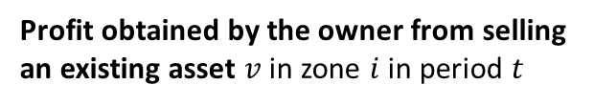
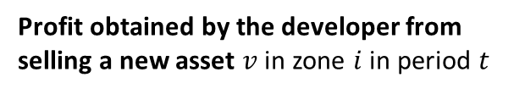


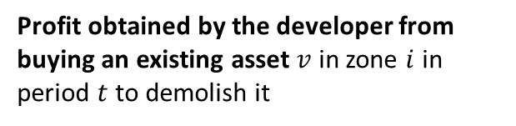





Model deep dive: model specification for selling assets
2
Profit obtained by the owner from selling an existing asset $v$ in zone $i$ in period $t$
Renewal cost of $v$ in $t$
Selling price of $v$ in $i$ in $t$
$$π_{SEvit}=−I_{Rvt}+p_{vit}$$
Profit obtained by the developer from selling a new asset $v$ in zone $i$ in period $t$
Development cost of $v$ in $i$ in $t$
Selling price of $v$ in $i$ in $t$
$$π_{SNvit}=−I_{Dvit}+p_{vit}$$
Demolish cost of $v$ in $i$ in $t$
Average profit from selling in $i$ in $t$
Profit obtained by the developer from buying an existing asset $v$ in zone $i$ in period $t$ to demolish it
$$π_{SNvit}=−c_{Dvit}q_{cvi}+π_{SNit}$$
Notes:
Explain the difference in notation. Is it relevant? More importantly, explain why is there a difference between owner and developer regarding costs.
Note that regarding the choice of selling or leasing:
It does not depend on renewal and developing costs: $\begin{matrix}π_{SPvit}>π_{LPvit} \\ π_{SNvit}>π_{LNvit}\end{matrix} ⟺p_{vit}>{CAP}_{vit}∗p_{vit}+\frac{p_{vi\left(t+T_{v}+1\right)}}{{\left(1+θ_{t}\right)}^{T_{v}+1}}$
If $p_{vi\left(t+T_{v}+1\right)}=p_{vit}$ and ${CAP}_{vit}<1−\frac{1}{{\left(1+θ_{t}\right)}^{T_{v}+1}}<1$, then the asset should be sold

